Slide 1


Slide 2
IoT-Based Fingerprint Attendance System Biometric Authentication using ESP32, AS608 Fingerprint Sensor, Blynk, Node-RED and Google Sheets

Slide 3
Presented by:
Ayesha Khalid(23-NTU-CS-1248)
Arooj Komal(23-NTU-CS-1140)
Faseeha Ahmad(23-NTU-CS-1251)

Slide 4
Introduction & Problem Statement
The Problem: Traditional attendance systems are manual, time-consuming, and prone to "proxy" errors.
The Solution: An IoT-enabled biometric system that uniquely identifies individuals and automates cloud-based record-keeping.
Key Benefits: Increased reliability, security, and real-time automation.

Slide 5
Project Objectives
Design a secure fingerprint-based authentication system.
Implement automatic enrollment for new users.
Develop real-time IoT dashboards for monitoring.
Automate data logging to Google Sheets while preventing duplicate entries.
Provide immediate user feedback via an OLED display.

Slide 6
System Architecture (Hardware)
Component | Function
ESP32 | Main controller with Wi-Fi for cloud connectivity.
AS608 Sensor | Biometric fingerprint scanning and matching.
OLED Display | Real-time status and user feedback messages.
Power Supply | Provides stable power to the system components.

Slide 7
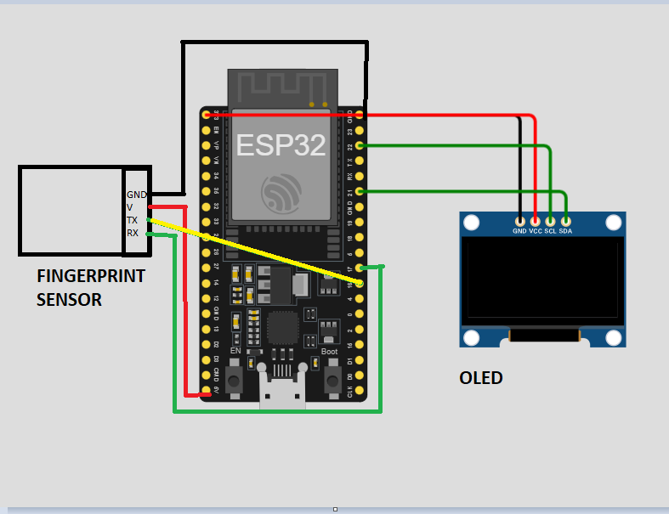
Circuit Diagram

Slide 8
Software Stack
Development Environment: PlatformIO (VS Code) with Arduino Framework
Phase 1 Platform: Blynk IoT app (used for initial testing and basic features)
Phase 2 Platform: Node-RED (web-based, advanced data flow and control)
Cloud Storage: Google Sheets integrated via Google Apps Script for attendance record keeping

Slide 9
Phase 1 – Implementation Using Blynk
In the first phase, the project was built using the Blynk IoT platform:
Features implemented:
Enroll button: To register new users
Text input widget: To enter user names
Attendance button: To mark attendance
OLED display: To give instant feedback to users
Google Sheets integration: To save attendance data on the cloud
Limitations of Blynk:
Limited options to customize widgets
Depended heavily on the mobile app
Difficult to implement complex logic or workflows
Challenging to do advanced debugging and control
Because of these limits, we upgraded the project to use Node-RED in the next phase.

Slide 10
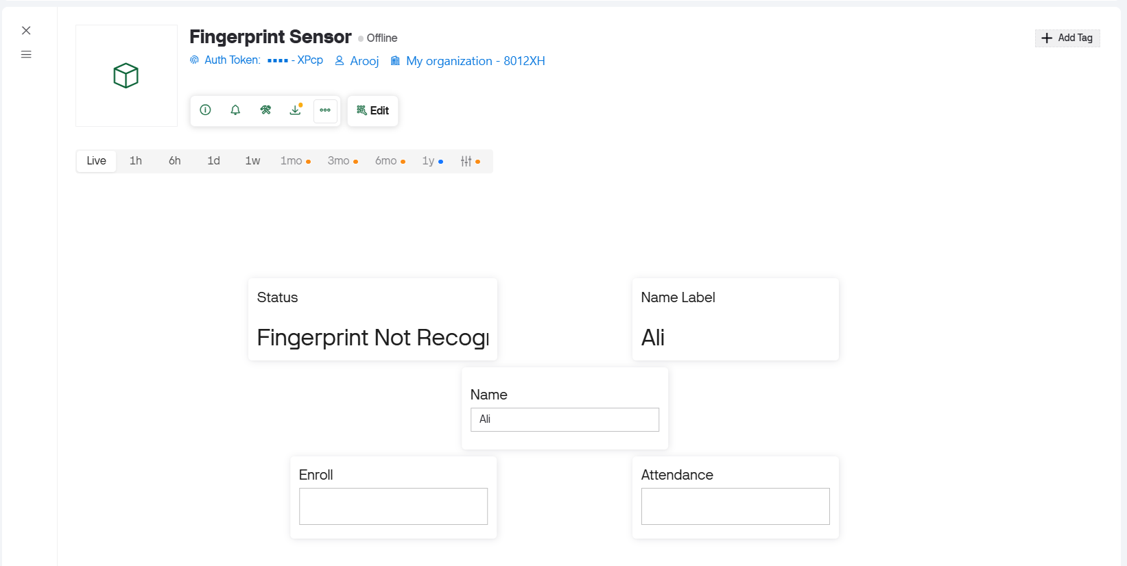
Blynk Dashboard

Slide 11
Phase 2 – Implementation Using Node-RED
In this phase, Node-RED was used as the dashboard and control platform:
Important Node-RED functions:
Trigger enrollment and attendance events
Display system status on dashboard
Prevent duplicate attendance entries
Send attendance data to Google Sheets
Key advantages of Node-RED:
Fully customizable web-based dashboard
Better control over data flow and logic
Easier integration with Google Sheets
Real-time data visualization and debugging

Slide 12
Working Principle
Initialization: ESP32 powers on and connects to the Wi-Fi network to ensure internet access.
Device Setup: Fingerprint sensor and OLED display are initialized and ready for use.
Enrollment: User enrolls their fingerprint by scanning twice to ensure accuracy.
ID Assignment: System assigns a unique fingerprint ID and links it to the user’s name.
Attendance Scan: User scans their fingerprint on the sensor to mark attendance.
Verification: ESP32 verifies the fingerprint by matching it with stored data.
Time Sync: Current date and time are fetched from the internet using NTP for precise timestamps.
Data Logging: Attendance data (user ID, name, date, and time) is sent securely to Google Sheets.
Duplicate Check: System prevents duplicate attendance entries for the same user on the same day to maintain accurate records.

Slide 13
USER ENROLLEMENT PROCESS
This is the process of registering a new person into the system database.
Initiation: The admin triggers the "Enroll" mode via the Node-RED or Blynk dashboard.
Name Assignment: The user’s name is entered into the system (via text input widget) to be mapped to a specific Finger ID.
Primary Scan: The user places their finger on the AS608 sensor for the first time.
Verification Scan: The user lifts and places the same finger again for a second scan to ensure consistency.
Storage: The fingerprint template is stored locally in the sensor’s memory, and the ID is synced with the cloud database.
Feedback: The OLED display shows a "Registration Successful" message.

Slide 14
ATTENDANCE VERIFICATION WORKFLOW
This is the daily automated process for marking a user as "Present".
Standby Mode: The ESP32 stays connected to Wi-Fi and waits for a finger to be placed on the AS608 sensor.
Biometric Matching: The sensor scans the finger and compares it against the stored templates.
Time Syncing: Upon a valid match, the ESP32 fetches the current date and time from the internet using the NTP (Network Time Protocol) server.
Duplicate Check: The system (via Google Apps Script) checks if that specific User ID has already marked attendance for the current date.
Cloud Logging: * If New: A new row is added to Google Sheets with Name, Date, Time, and "Present" status.
Visual Confirmation: The OLED display confirms the attendance marked or warns if it is already present.

Slide 15
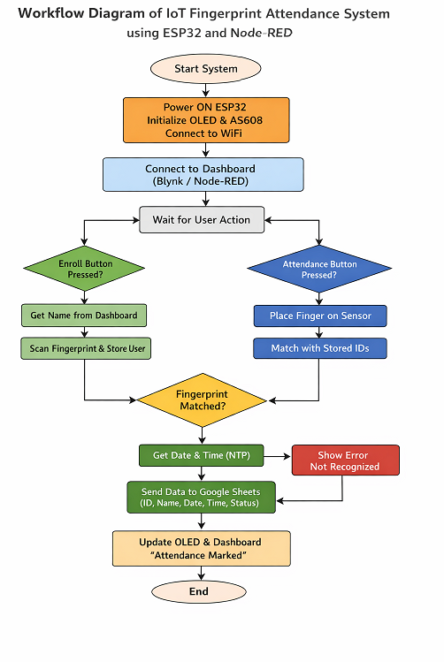
Flowchart

Slide 16
Data Management (Google Sheets)
Cloud Database
Google Sheets used as database
Data sent via HTTP request
Google Apps Script handles data
Stored Parameters
• Finger ID • Name • Date • Time • Status
Real-time Storage: Automatically records Finger ID, Name, Date, Time, and Status.
Smart Updates: Google Apps Script is used to check for existing records and update them if attendance is already marked for that day.

Slide 17
GOOGLE SHEETS DATA FORMAT
Finger_ID | Name | Date | Time | Status
1 | Ali | 07-01-2026 | 09:15 | Present
Special Feature
• Duplicate attendance prevented • Existing record updated

Slide 18
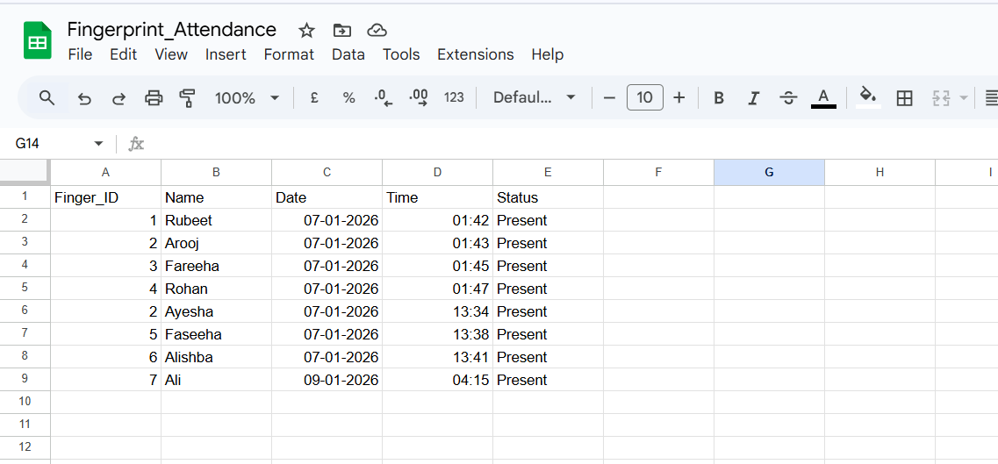
Google Sheets Database

Slide 19
Testing and Validation
Test Case | Result
Valid fingerprint | Attendance marked
Same user twice | Duplicate prevented
Invalid fingerprint | Access denied
Wi-Fi disconnection | Auto reconnection
Power reset | System resumes

Slide 20
Conclusion
The system successfully automates attendance management by integrating biometric authentication with cloud storage.
The project evolved through two phases, starting with Blynk for prototyping and migrating to Node-RED for enhanced reliability.
Key objectives were met, including real-time data logging, duplicate prevention, and providing clear user feedback via OLED.
The final solution is a secure, efficient, and scalable tool suitable for educational or corporate environments

Slide 21
Future Enhancements
Integrate Face Recognition for multi-factor authentication
Implement Offline Storage to handle internet outages
Add SMS/Email notifications for attendance alerts to parents or managers
Develop a dedicated Admin Web Portal and mobile app for better management

